Slide 1
Approaches to Management
Session 2

Slide 2
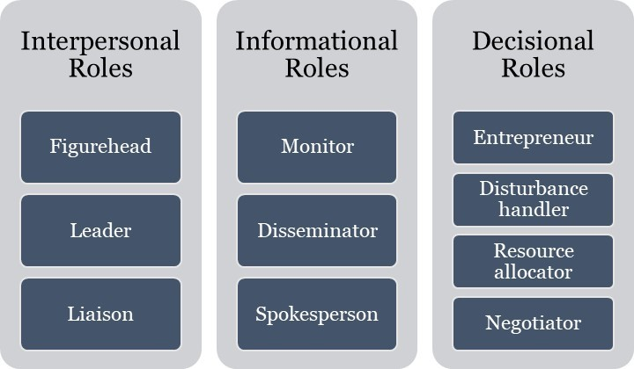
Approaches to Management
The Managerial roles approach(Henry Mintzberg)

Slide 3
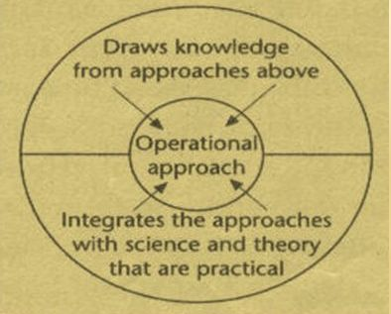
Management process or Operational Approach

Slide 4
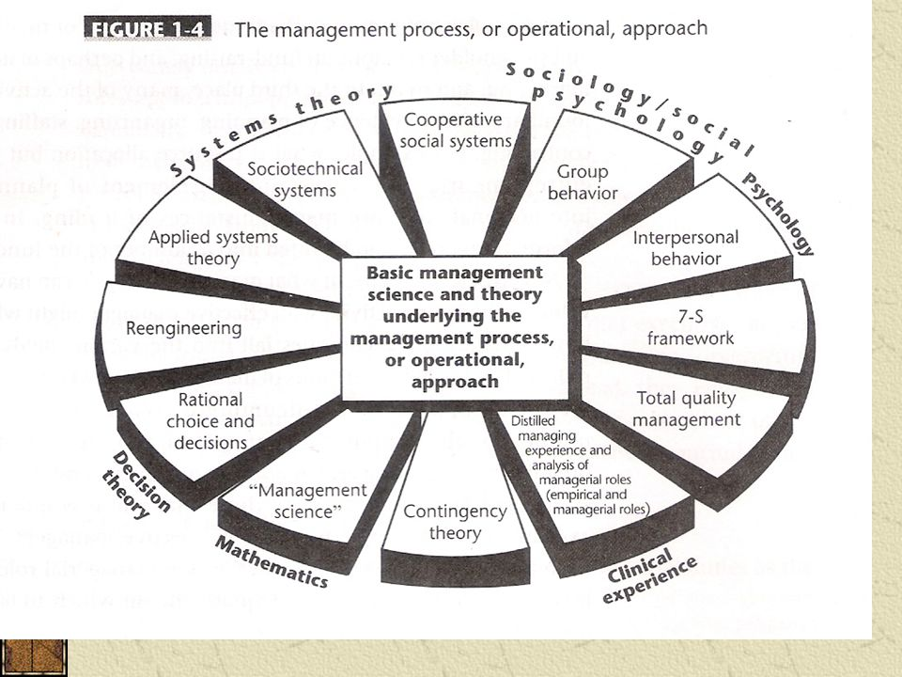

Slide 5
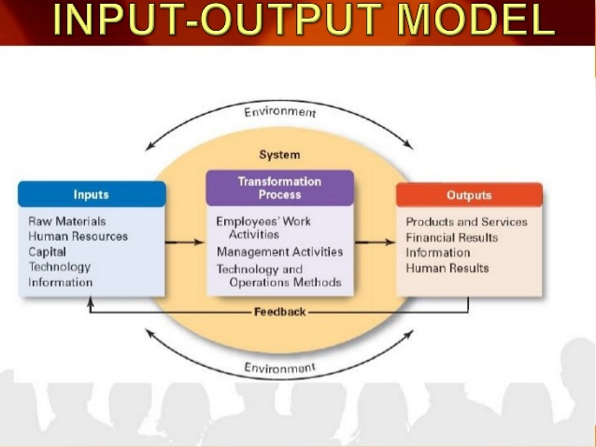
Systems approach to the Management Process

Slide 6
